Slide 1
Lecture 10: Reduction
Chris Walshaw
Computing & Mathematical Sciences
University of Greenwich

Slide 2
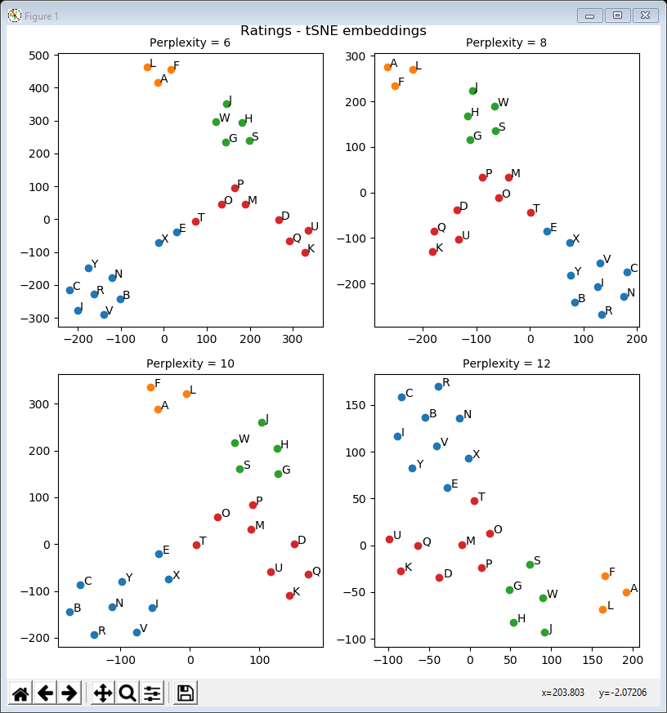
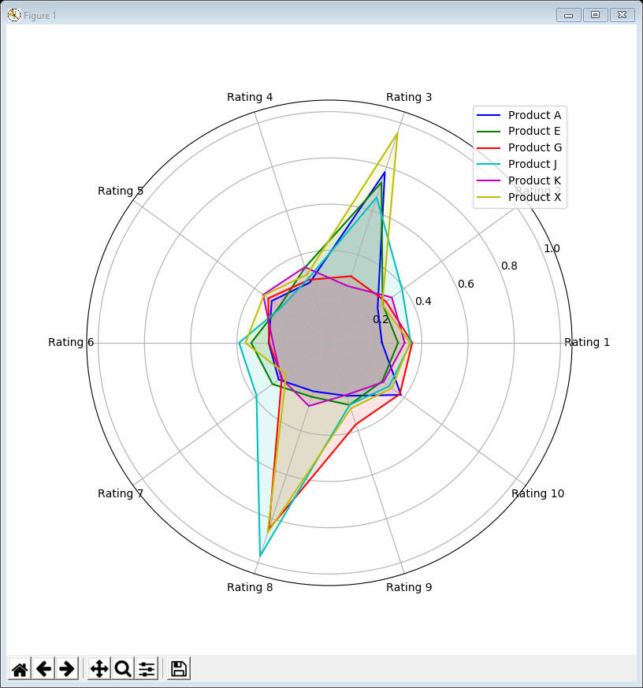
Motivation / Objectives
Last week we looked at clustering
a crucial visualisation technique for understanding large-scale/data-intensive applications
And in lecture 6 we looked at how to cope with multiple dimensions
bubble plots for 3 dimensions, radar plots for more
But for really data-intensive applications these may not be enough to interpret the clustering results
This week we look at dimension reduction to help understand the structure of data using …
scatter plots for structure
radar plots for interpretation

Slide 3
What is dimension reduction?
Many data-intensive applications have too many variables to get a sense of the “shape” / “structure” of the data
e.g. bubble plots can deal with 3 dimensions, radar plots can help with ~6 but what if there are 300 or 600?
Dimension reduction is a way of embedding the data into 2 dimensions so that we can look at the structure
A popular method for dimension reduction is called Principal Component Analysis (PCA)
invented in 1901(!!), but it’s linear, so can’t really cope with complex data
Recently a technique called t-distributed Stochastic Neighbour Embedding (t-SNE) has become popular
often used in combination with PCA for very high dimensions (e.g. use PCA to reduce to ~50 dimensions and t-SNE to reduce to 2 dimensions)
both are included in the scikit-learn library
from sklearn.decomposition import PCA
from sklearn.manifold import TSNE

Slide 4
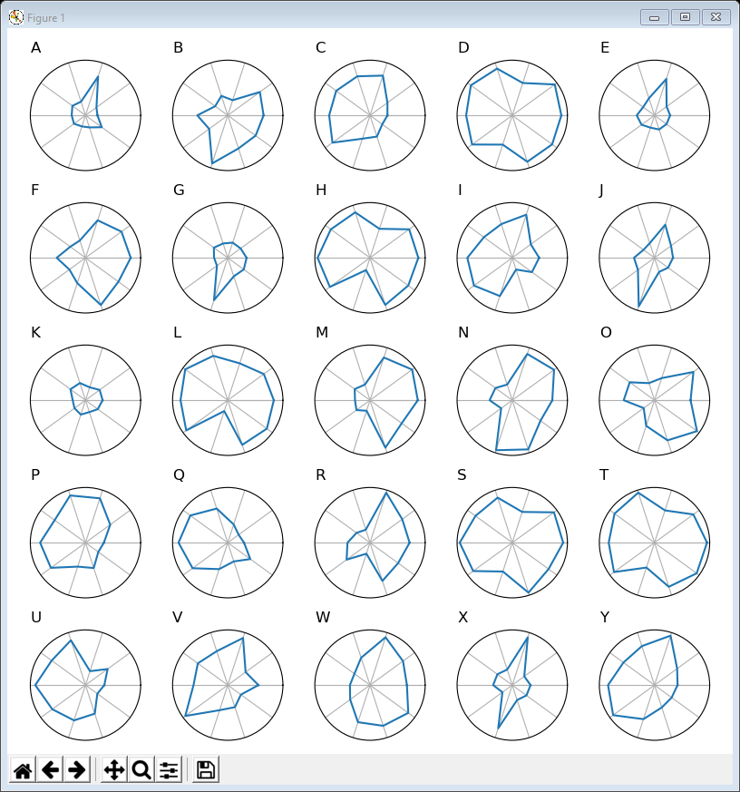
01RadarPlot ratings subplots.py
First let’s explore the ratings from last week
10 ratings per product, so 10 dimensions with 25 data-points each
k-means algorithm says there are 4 clusters
but can’t visualise what they look like so hard to interpret what they represent
Radar plots are a start
the code is the same as example 10 from last week
As an initial interpretation, notice that some products have consistently good ratings (D, S, T) and some consistently poor (A, E, G, K)

Slide 5
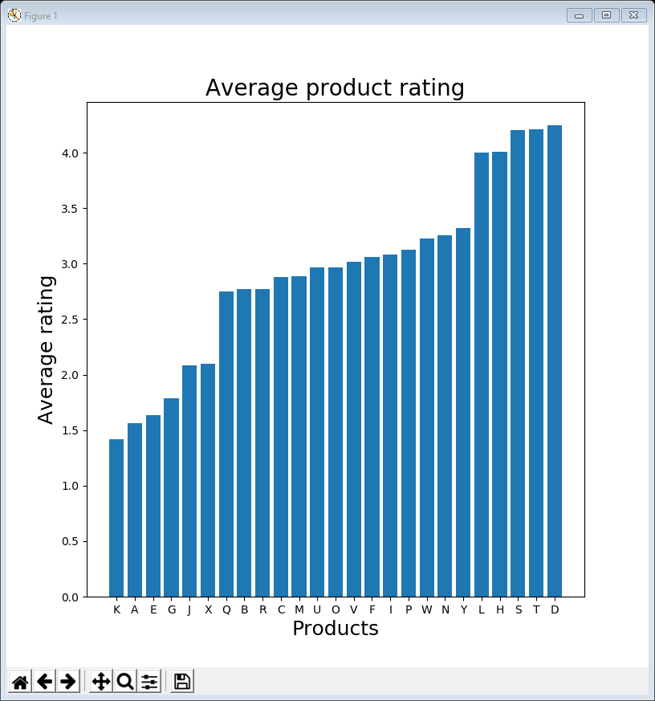
02BarChart ratings sorted.py
First let’s calculate the average ratings, sort them, and create a bar chart
code is almost identical to lecture 2, example 8
Low ratings: K, A, E, G, J, X
High ratings: L, H, S, T, D
data = ratings.transpose()
data = data.reindex(data.mean().sort_values().index, axis=1)
plt.figure(figsize=(8, 8))
x_pos = np.arange(len(data.columns))
plt.bar(x_pos, data.mean(), align='center')
plt.xticks(x_pos, data.columns)
plt.xlabel('Products', fontsize=18)
plt.ylabel('Average rating', fontsize=18)
plt.title('Average product rating', fontsize=20)
plt.show()

Slide 6
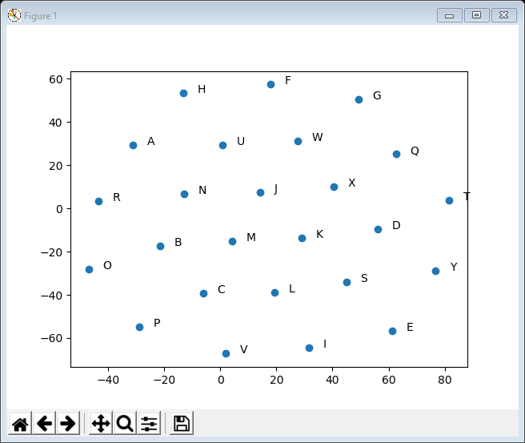
03TSNE ratings default.py
Using t-SNE to create an embedding is easy
The line in bold actually does the embedding
it returns a 2-dimensional list of x, y values for each data-point which we can show in a scatter plot
The loop just labels all the data-points
like before
data = ratings
embedding = TSNE(n_components=2, random_state=0)
.fit_transform(raw_data.values)
plt.figure()
plt.scatter(embedding[:, 0], embedding[:, 1])
for i, name in enumerate(raw_data.index):
plt.annotate(name, (embedding[i, 0] + 5, embedding[i, 1]))
plt.show()
but the result is not very revealing and doesn’t even group high / low ratings

Slide 7
Perplexity
One of the key parameters for t-SNE is called perplexity
According to Laurens van der Maaten, the inventor of t-SNE
“The perplexity may be viewed as a knob that sets the number of effective nearest neighbours”
“Loosely speaking, one could say that a larger / denser dataset requires a larger perplexity. Typical values for the perplexity range between 5 and 50”
see https://lvdmaaten.github.io/tsne/
So in practice it’s a good idea to experiment with different perplexities

Slide 8
04TSNE ratings varying perplexity.py
Example 4 uses 9 different perplexities (the scikit-learn default is 50) and creates a subplot for each
You can experiment with these values
counter = 1
fig = plt.figure(figsize=(8, 8))
fig.suptitle('Ratings - tSNE embeddings', position=(0.5, 1.0))
perplexities = [4, 6, 8, 10, 12, 15, 20, 25, 30]
for p in perplexities:
embedding = TSNE(n_components=2, random_state=0, perplexity=p)
.fit_transform(raw_data.values)
sub = fig.add_subplot(3, 3, counter)
sub.set_title('Perplexity = ' + str(p), fontsize=10)
plt.scatter(embedding[:, 0], embedding[:, 1])
counter += 1
fig.subplots_adjust(wspace=0.5, hspace=0.5)
fig.tight_layout()
plt.show()

Slide 9
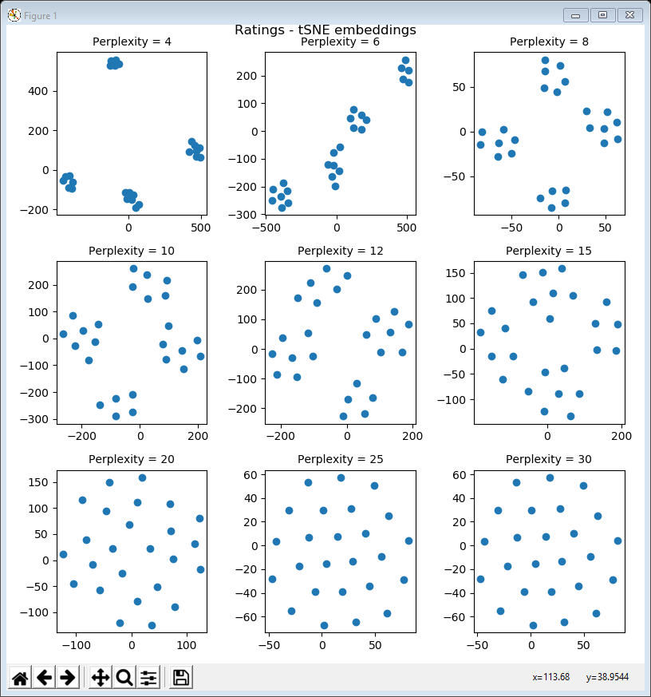
04TSNE ratings varying perplexity.py
for perplexity = 4 there are 4 tight clusters (too tight)
but for perplexity = 6, 8, 10, 12, 15 there are 4 well-spaced clusters
for perplexity = 20, 25, 30 the data-points don’t show much structure

Slide 10
Interpreting t-SNE results
In absolute terms, the positions of the data-points mean nothing
However, if a set of data-points are close together that means that they may represent a cluster of data
especially if the same set of data-points is always clustered for a number of different perplexity values
And as before, clusters represent data-points that are similar in some way
But what do the 4 clusters represent???

Slide 11
Understanding t-SNE results
As with k-means clustering, fundamentally we want to understand why data is clustered to make sense of the dataset
One way of doing that manually is as follows:
manually identify a group of data-points using a simple rule (e.g. high volume or low ratings)
split the dataset into two subsets, our group … and all the others
create a number of t-SNE embeddings at different perplexities and plot the grouped data in a different colour to the others
If our group consistently matches a t-SNE cluster, then we “know” what rule is generating that cluster

Slide 12
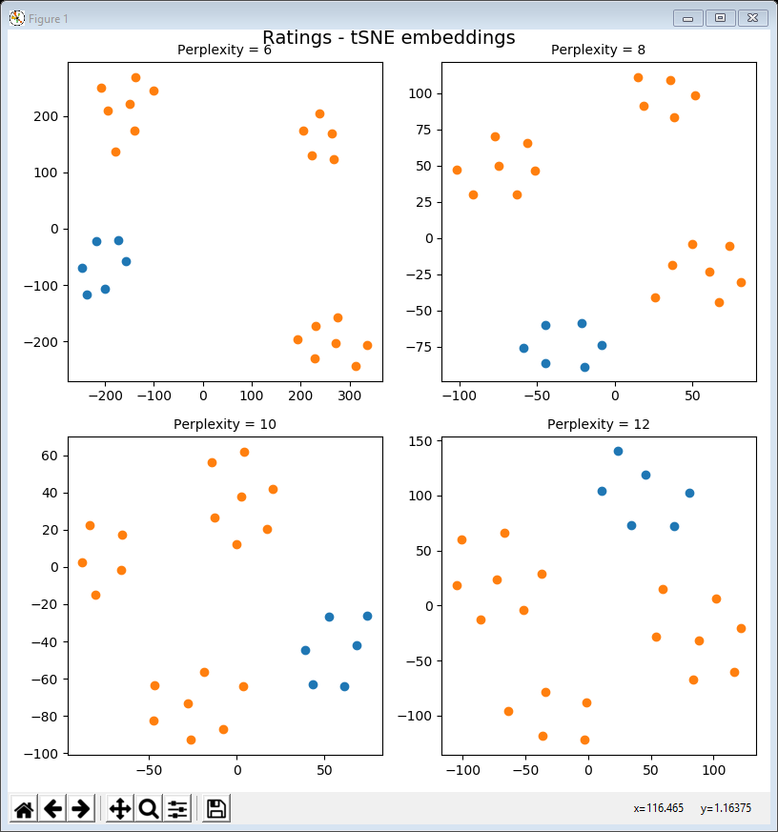
05TSNE low ratings.py
Example 5 groups low rated products (K, A, E, G, J, X)
we won’t look at the code in detail (similar to example 4 but with 2 groups)
Low rated products are in blue
others are in orange
Perplexities are 6, 8, 10, 12
so one of the t-SNE clusters represents low rated products
so one of the t-SNE clusters represents low rated products
so one of the t-SNE clusters represents low rated products
so one of the t-SNE clusters represents low rated products
but remember that absolute positions don’t mean anything

Slide 13
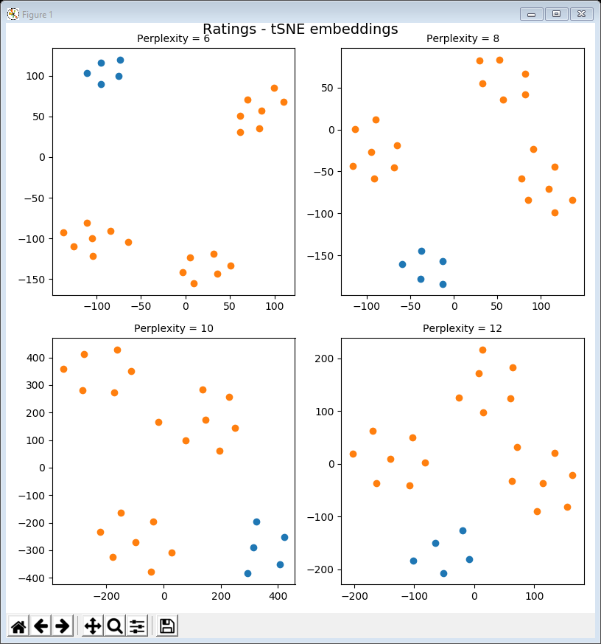
06TSNE high ratings.py
Example 6 groups high rated products (L, H, S, T, D)
High rated products are in blue
others are in orange
Perplexities are 6, 8, 10, 12
so one of the t-SNE clusters represents low rated products
so one of the t-SNE clusters represents low rated products
so another of the t-SNE clusters represents high rated products
so one of the t-SNE clusters represents low rated products

Slide 14
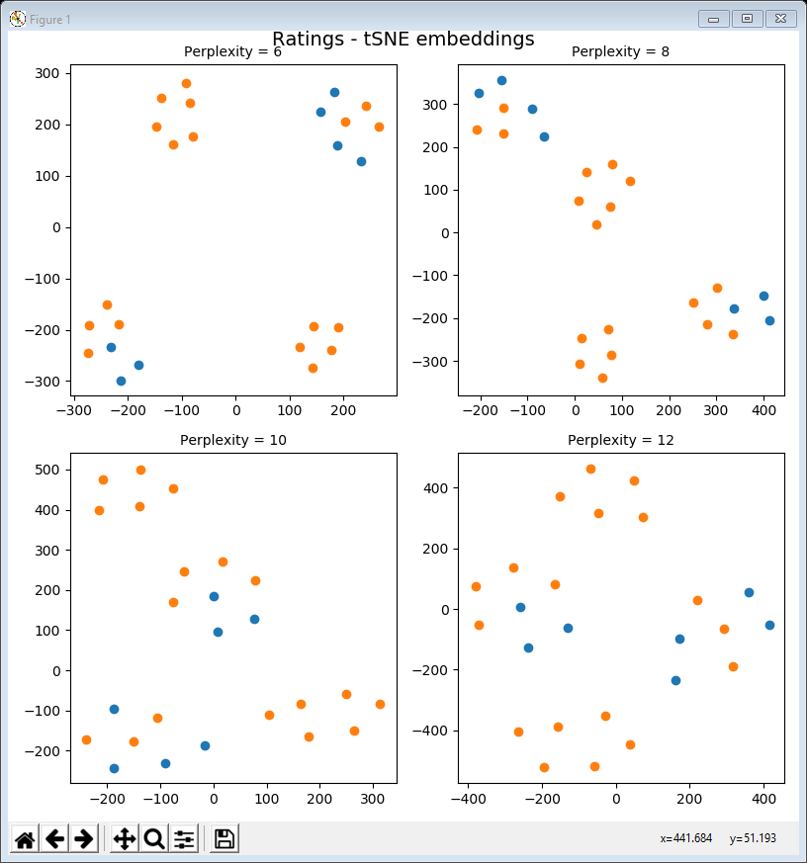
07TSNE low mid ratings.py
Example 7 groups low-mid rated products (Q, B, R, C, M, U, O)
see example 2
Low-mid rated are in blue
others are in orange
Perplexities are 6, 8, 10, 12
so this doesn’t work to interpret the other two clusters
instead let’s cluster the data with k-means and then look at the t-SNE embedding

Slide 15
08TSNE clustered ratings.py
Example 8 is a useful script for clustering and embedding
e.g. can check that both agree with each other
You can easily use this script for other data
just have to change these parameters
Here the raw data is clustered and the clusters listed
k = 4
raw_data = ratings
perplexities = [6, 8, 10, 12]
annotate = False
clusters = []
k_means = KMeans(n_clusters=k, init='k-means++', random_state=1)
raw_data['label'] = k_means.fit_predict(raw_data)
for c in range(k):
cluster = raw_data[raw_data['label'] == c]
print('cluster' + str(c) + ' = ' + str(list(cluster.index)))
clusters.append(cluster.drop(['label'], axis=1))
clustered_data = pd.concat(clusters)

Slide 16
08TSNE clustered ratings (cont’d)
Next a number of embeddings are calculated, each for a different perplexity value
And the embedding for each cluster is put into its own dataframe which is then stored in a list of embedded_clusters
for p in perplexities:
embedding = TSNE(n_components=2, random_state=0, perplexity=p)
.fit_transform(clustered_data.values)
embedded_clusters = []
cluster_start = 0
for cluster in clusters:
cluster_end = cluster_start + cluster.shape[0]
embedded_clusters.append(embedding[cluster_start:cluster_end, :])
cluster_start = cluster_end

Slide 17
08TSNE clustered ratings (cont’d)
In the same loop, the embedded clusters are visualised in a scatter plot
each cluster has a different colour
You can decide to annotate the data-points by setting annotate = True in the parameters at the top
counter = 1
fig = plt.figure(figsize=(8, 8))
fig.suptitle('Ratings - tSNE embeddings', position=(0.5, 1.0))
for p in perplexities:
... # the embedding is calculated here
sub = fig.add_subplot(2, 2, counter)
sub.set_title('Perplexity = ' + str(p), fontsize=10)
for embedded_cluster in embedded_clusters:
sub.scatter(embedded_cluster[:, 0], embedded_cluster[:, 1])
if annotate:
for i, name in enumerate(clustered_data.index):
sub.annotate(name, (embedding[i, 0] + 5, embedding[i, 1]))
counter += 1
fig.subplots_adjust(wspace=0.5, hspace=0.5)
fig.tight_layout()
plt.show()

Slide 18
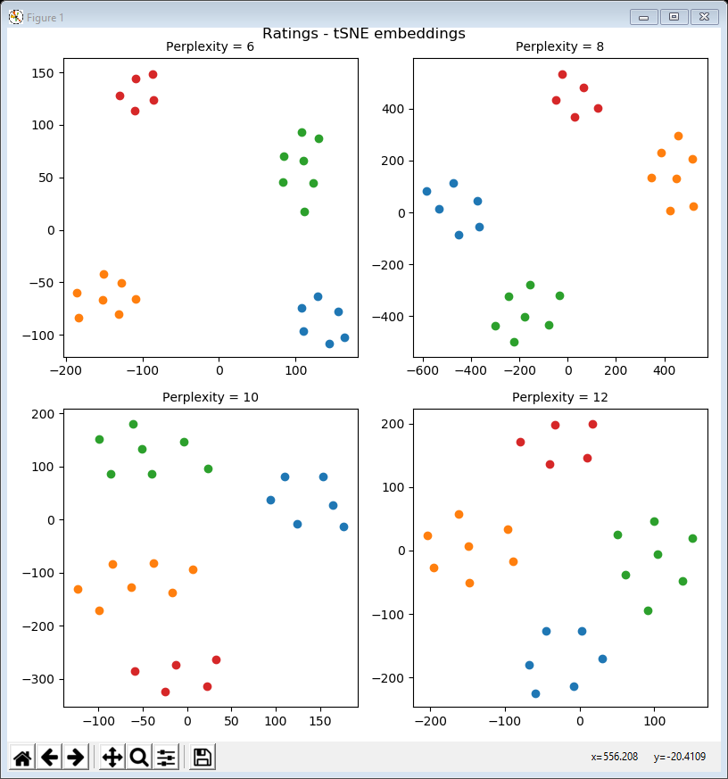
08TSNE clustered ratings (cont’d)
Here are the results:
clearly the k-means clustering matches the t-SNE embedded clusters
low rated (blue) and high rated (red) products are always grouped together
the other two clusters are
C, I, P, Q, U, V, Y (orange)
B, F, M, N, O, R, W (green)
(contents are printed out)

Slide 19
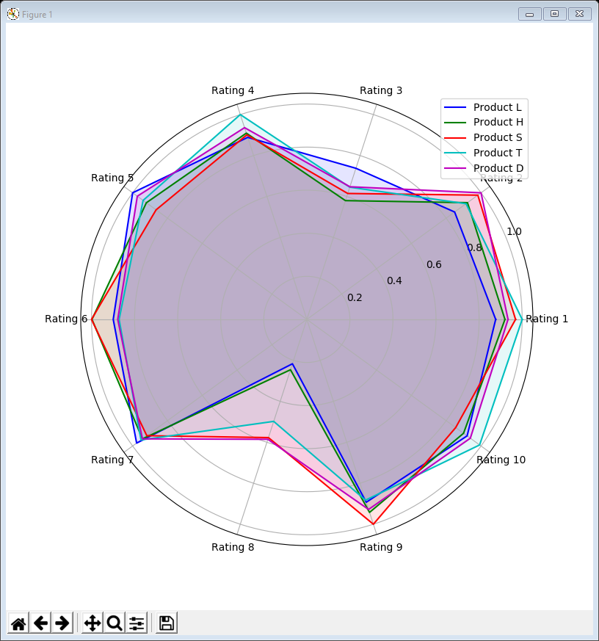
Examples 9 & 10
If we can’t easily spot a “rule” for deriving these clusters, can return to overlaid radar plots – first let’s do low / high ratings
The code is exactly the same as lecture 6, example 6, except
for example 9, select low ratings
for example 10, select high ratings
normalised_data = ratings / ratings.max()
selected = ['A', 'E', 'G', 'J', 'K', 'X']
normalised_data = ratings / ratings.max()
selected = ['L', 'H', 'S', 'T', 'D']
so the values are consistently low except ratings 3 & 8 where they can be high or low
so the values are consistently high except ratings 3 & 8 where they can be high or low

Slide 20
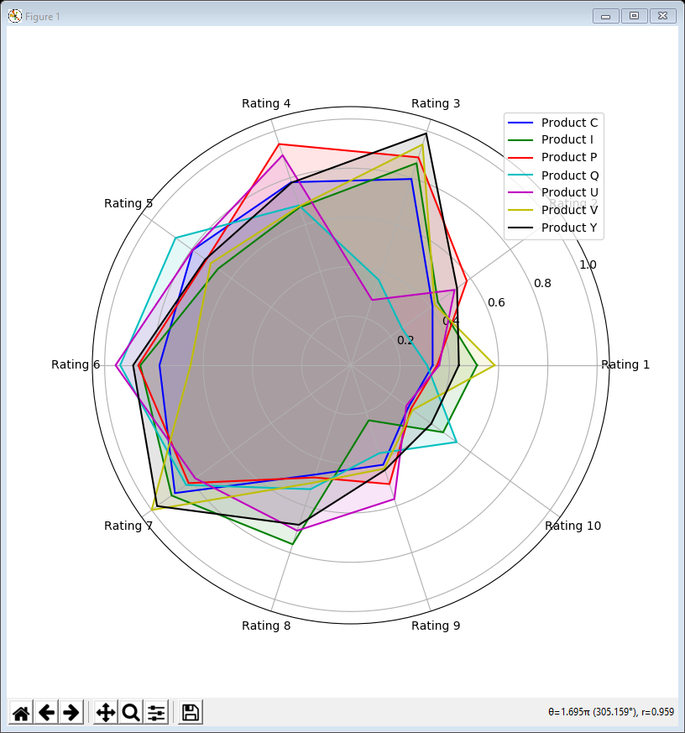
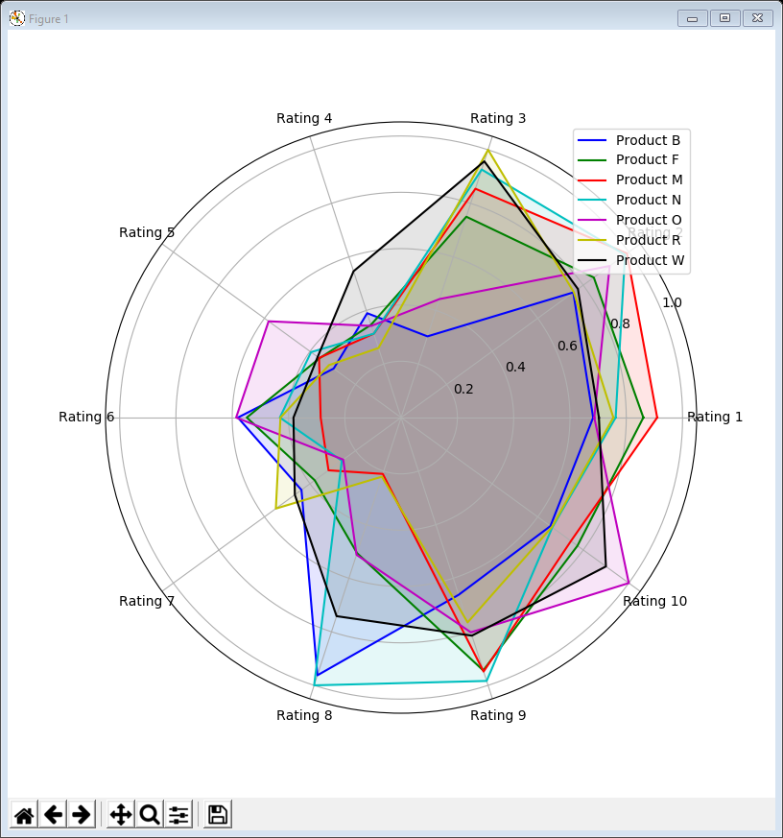
Examples 11 & 12
We can use the same code for the unidentified clusters
for example 11
for example 12
selected = ['C', 'I', 'P', 'Q', 'U', 'V', 'Y']
selected = ['B', 'F', 'M', 'N', 'O', 'R', 'W']
high ratings for 4, 5, 6, 7
low for 1, 2, 9, 10
either for 3, 8
high ratings for 1, 2, 9, 10
low for 4, 5, 6, 7
either for 3, 8

Slide 21
Ratings clusters interpretation
So, ignoring values for ratings 3 & 8, the ratings data falls into 4 distinct clusters
high ratings for 1, 2, 4, 5, 6, 7, 9, 10
low ratings for 1, 2, 4, 5, 6, 7, 9, 10
high ratings for 4, 5, 6, 7 / low ratings for 1, 2, 9, 10
low ratings for 4, 5, 6, 7 / high ratings for 1, 2, 9, 10
The fact that ratings 3 & 8 don’t impact on this clustering makes it much harder to detect manually

Slide 22
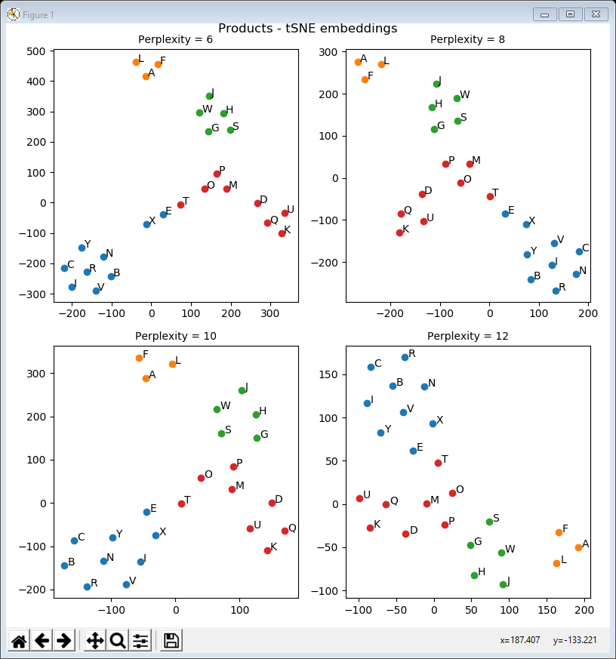
13TSNE summary data.py
both pick out high volume (orange) and medium volume (green) as clusters
Let’s apply the same techniques to the summary data
can easily adapt example 8 (only changes shown in bold)
Here we cluster the full 5 dimensional dataset (Price, Profit, Sales, Marketing, Cost)
rather than just Marketing & Sales as in lecture 9, example 1
k = 4
raw_data = summary_data
annotate = True
perplexities = [6, 8, 10, 12]
plus 2 other clusters (red / blue) which t-SNE puts adjacent to each other
the k-means clusterings and t-SNE embeddings are not strikingly similar, but obviously related

Slide 23
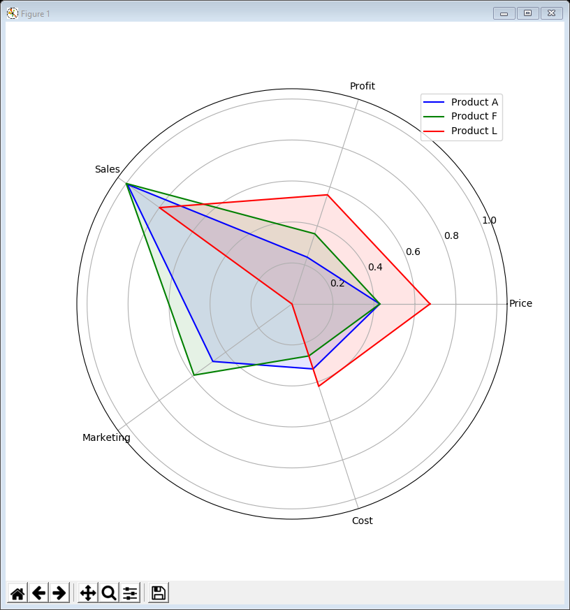
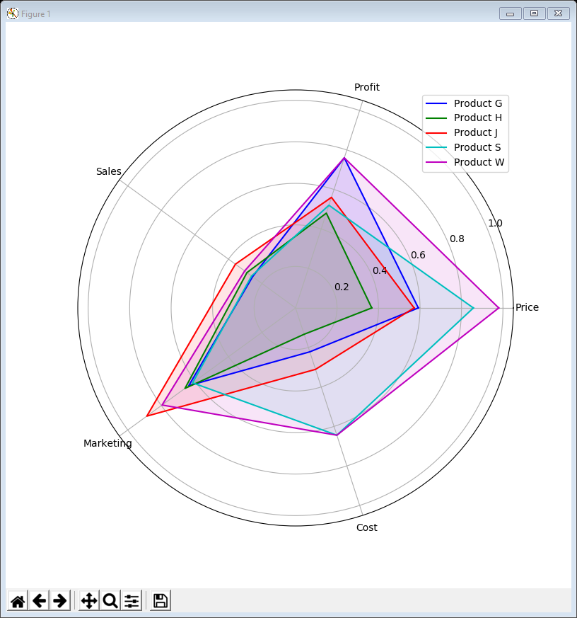
Examples 14 & 15
Again we can use overlaid radar plots to investigate
high volume
medium volume

Slide 24
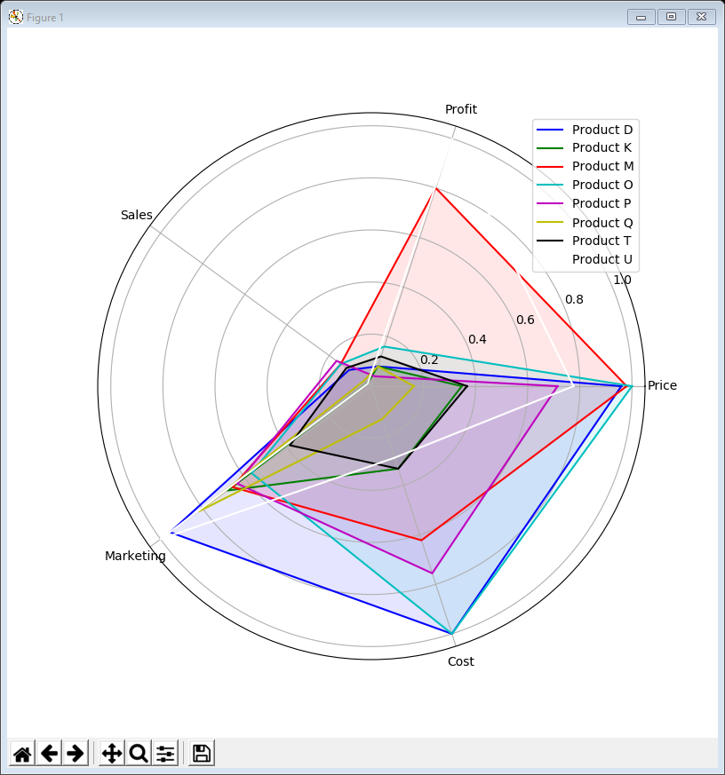
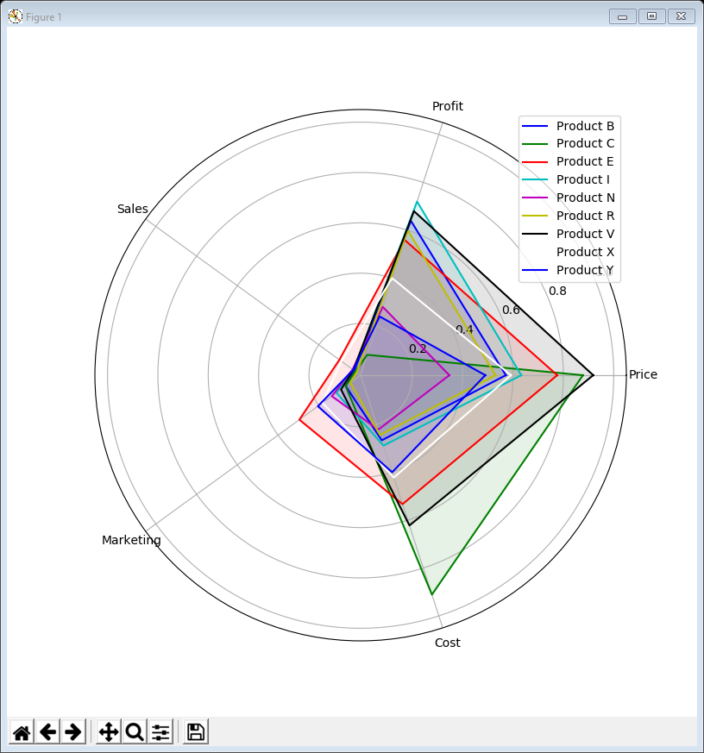
Examples 16 & 17
The other two clusters are low volume but seem to be distinguished by their marketing spend
higher marketing spend
lower marketing spend

Slide 25
Data conclusions
By combining k-means clustering and t-SNE embedding we can identify & visualise structures in the data
In the ratings data there are 4 straightforward clusters
but they would not be easy to spot manually as ratings 3 & 8 seem to have no influence on clustering
In the summary data, t-SNE generates a curved cluster which k-means splits into 2 parts (but neither matches the low / very low volume segmentation we found in lecture 2)
also the middle of the curved cluster is close to the medium volume cluster
So for the summary data the strongest influence on clustering seems to be volume of sales
but for low / very low volume sales the marketing spend influences how the data-points are grouped

Slide 26
Lecture summary
Can use t-SNE to help visualise clusterings in high dimensions (i.e. anything more than 3 variables) …
… but there is no guaranteed method for explaining the “rule” behind each cluster
radar plots can help but may not work for large and/or high-dimensional data
Nonetheless, clustering and dimension reduction are extremely helpful techniques in data exploration

